Slide 1
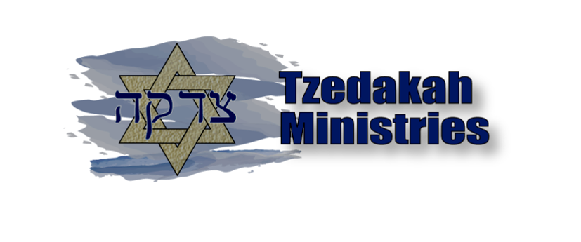
A Fear of Loss of Community as a Hindrance to the Gospel in Jewish Evangelism
Amy Downey – Director
Tzedakah Ministries

Slide 2
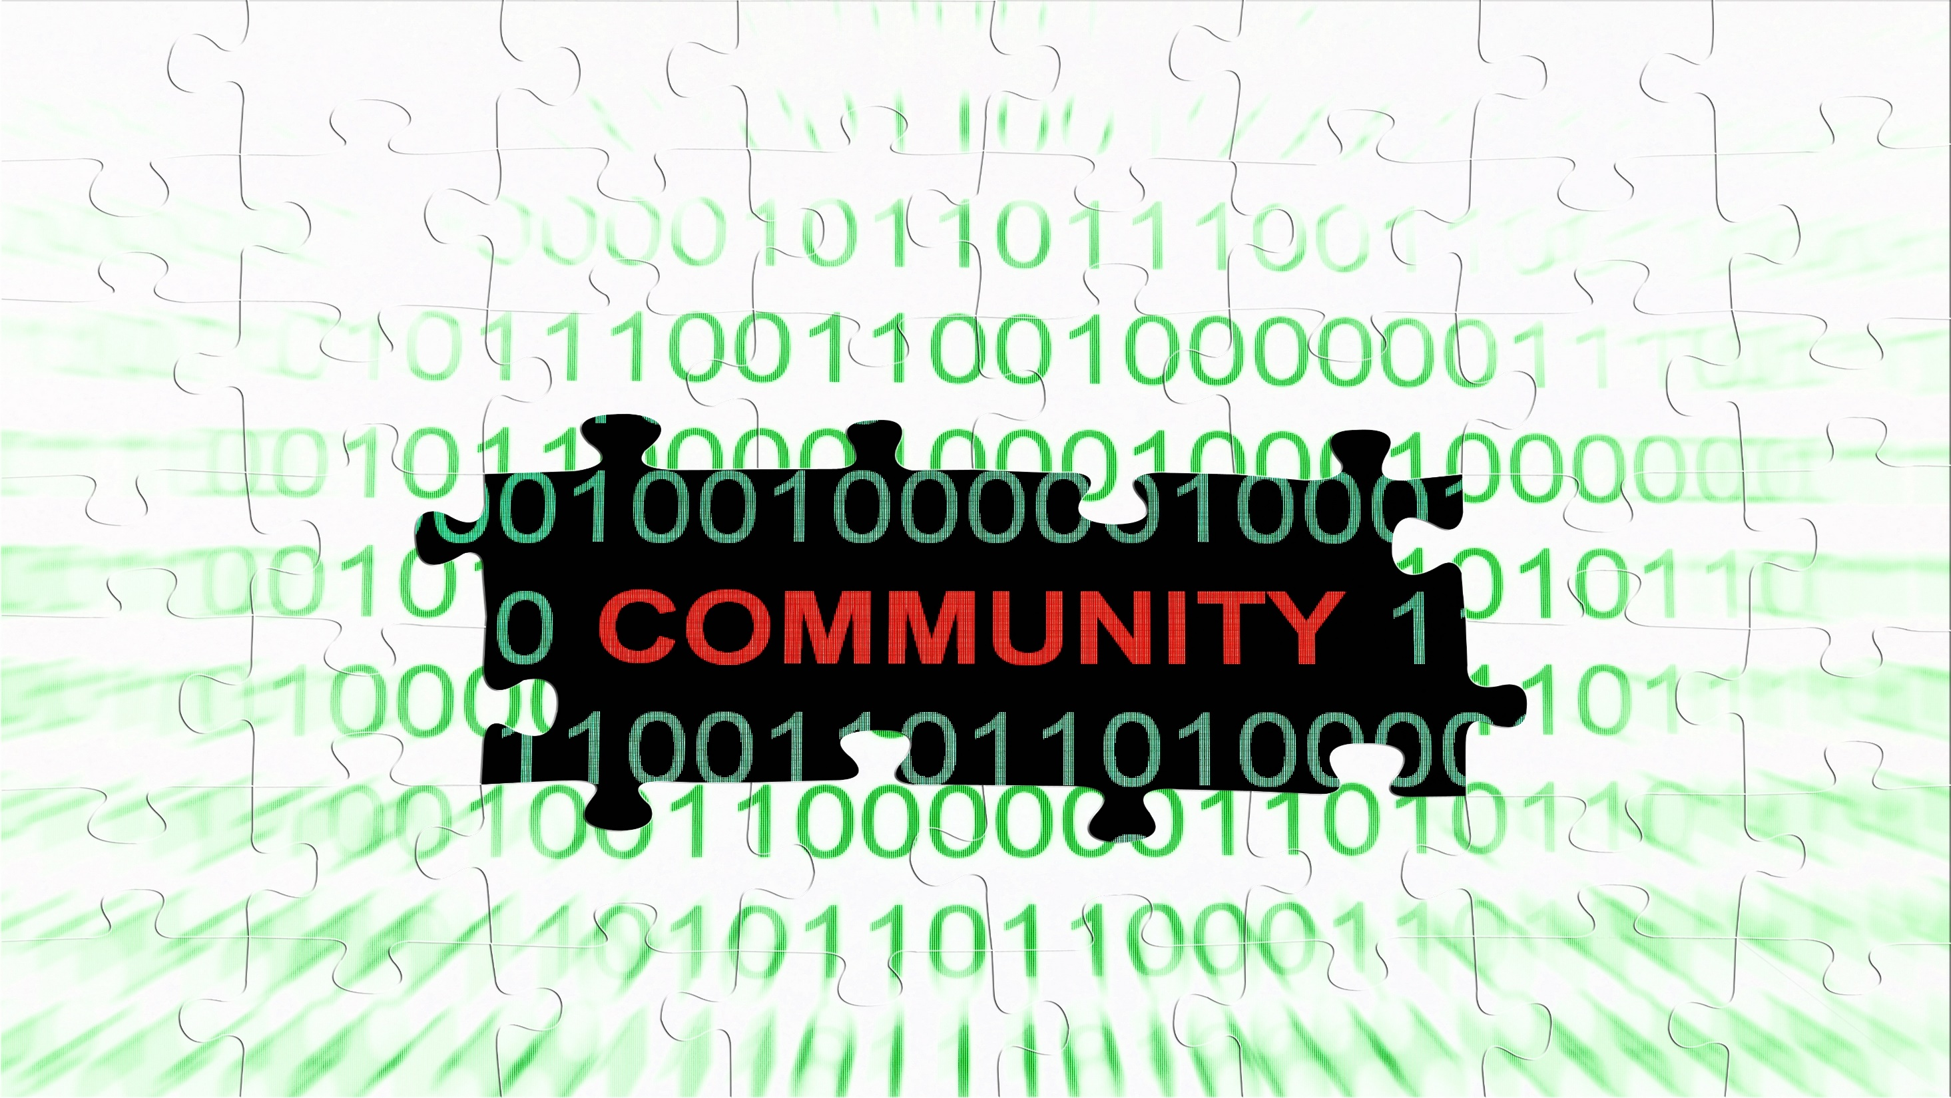

Slide 3
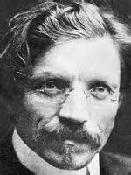
“You can take a Jew out of a shtetl, but you cannot take a shtetl out of a Jew.”
-- Sholom Aleichem

Slide 4

“The Jewish community is all about love and family, which is the most important thing in my life, too.”
-- Gregg Sulkin (Disney Channel/MTV Actor)

Slide 5

“What one Christian does is his own responsibility, what one Jew does is thrown back at all Jews.”
-- Anne Frank

Slide 6
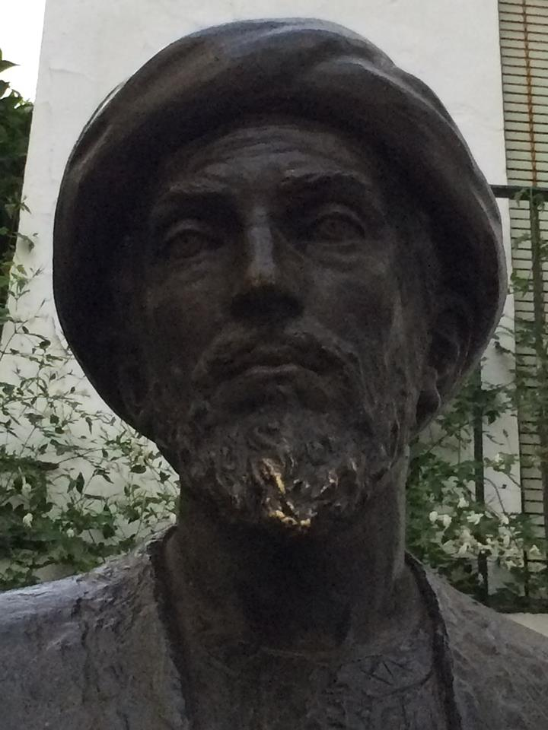
“A person who separates himself from the congregation of Israel and does not fulfill mitzvot together with them, does not take part in their hardships, or join in their [communal] fasts, but rather goes on his own individual path as if he is from another nation and not [Israel], does not have a portion in the world to come.”
-- Rambam (Mishneh Torah, Teshuvah 3:11)

Slide 7
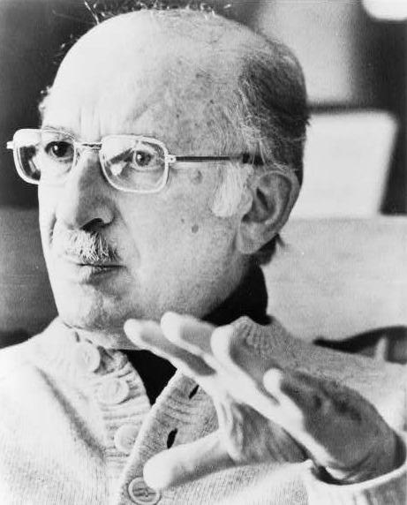
“If you ever forget you’re a Jew, a Gentile will remind you.”
-- Bernard Malamud (Pulitzer Winner, Agnostic
humanist but buried in a Jewish cemetery)

Slide 8
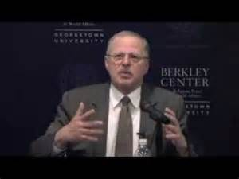
“One cannot accept Christ and still be part of the normative Jewish community; one cannot live by Torah and still be part of the Church.”
-- Rabbi David Novak

Slide 9
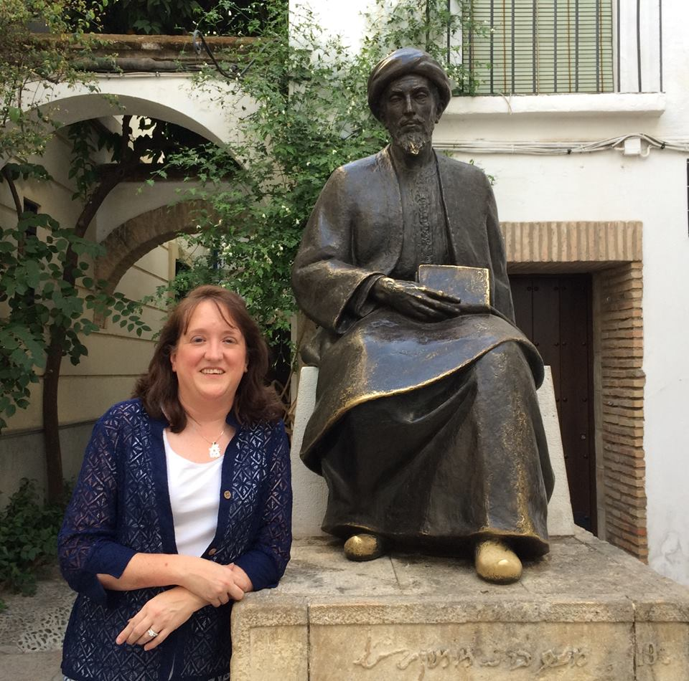
“When a man accepts all of these principles, fully believing in them, he enters into the community of Israel and we are bound to love him, to show mercy to him, and to fulfill with respect all of the duties God imposed regarding love and brother-hood… But if he rejects one of these principles, he leaves the community and denies [the Torah], and he is called a heretic and an apostate, and we are obligated to hate him and destroy him.”
-- Rambam (Introduction to Pereq Heleq)

Slide 10

Does the Jewish world see the Gospel message as worth the risk? The risk of losing their community?
Are we as the Messianic AND Christian communities responding as we should?

Slide 11
How Does One Define the Jewish Community at Large?...
Is it merely with words? – Am, Chavurah, Edah, Kehillah, Minyan, Kevutzah
Is it merely with a definition or two?
  “It is the mutual voice of Jewish responsibility that most closely resembles being members of an extended family with all of the joys, anxieties, frustrations, idiosyncrasies, and responsibilities that membership in a family brings.” (The Case for Jewish Peoplehood – Drs. Erica Brown and Misha Galperin)
  Centered around the idea that people of like interests, like heritage, like faith will bond together to support and encourage each other for the purpose of self-perpetuation

Slide 12
How Does One Define the Jewish Community at Large?...
Is it merely with historical and cultural reality?
  The concept of community is the glue which held the Jewish people together through the 2,000 years of Diaspora Living
  The concept of community has allowed the Jewish people to maintain a unique ethnic, cultural and religious identity ... regardless of geographical and/or linguistic differences
  The concept of community continues to keep the Jewish people together regardless of religious and political views
Ultimately, there is no “merely” to the importance of community to the Jewish World

Slide 13

For in the Jewish world or community …
“No man is an island, entire of itself.”
However … this is what a Jewish believer faces unless the Messianic AND Christian Community respond more effectively.

Slide 14
For Example … Growing in Faith through One’s Daily Prayer Walk
Communal Prayer vs. Believer’s “Quiet Time”
  “Communal prayer is always heard by God. The Holy One Blessed be He never rejects the prayers of the many, even if there are sinners among them. Therefore, a person should always participate with a congregation and never pray alone whenever he can pray with a congregation” (Mishneh Torah, Tefilah and Birkat Kohanim 8:1)
Prescribed Daily Prayers vs. Pray without Ceasing
  Midrash Tanhuma Miqqez, 11
To Whom Do We Pray? – “In Jesus’ Name…?!

Slide 15
For Example … Walking through the Valley of the Shadow of Death
Sitting Shiva vs. Church Potluck Meal and Then What…
  “As for those who deviated from the practices of the congregation —that is, men who cast off the restraint of the commandments, did not join their fellow Jews in the performance of the precepts, observance of festivals, attendance at Synagogue and House of Study, but felt free to do as they pleased in the manner of other nations, as well as for epicureans, apostates, and delators—for these no mourning is observed.” (Mishneh Torah, Sefer Shoftim, Avel, 1:10)
  “Mourning thus becomes a way to mark the community’s boundaries, identifying the line between those considered to be within it and those regarded as outside it.” (Moshe Halbertal, Maimonides, p. 238)

Slide 16

Developing a “New” Sacred Canopy* of Community for Jewish Evangelism
Sacred Canopy is a concept term taken from Peter Berger

Slide 17
A Working Model of a Sacred Canopy … With Room to Evolve (Return to Acts 2)
Jewish Mission Organizations Providing Support Each Step of the Way
Churches
#1 avenue for Jewish missions
Congregations
Discipleship w/ Jewish roots
College & Millennials
Age when most open to Gospel
Messianic Community Centers
Avoiding the
Messianic Shtetl
Neutral site where “Torah observance” is not an issue
Discipleship but needs stronger Jewish roots
Roots but not always “Jewish” congregation
Most resistant to organized religion
Engage in & with the Jewish community
Avoid the “Wall”
Meet local needs united

Slide 18
Adapted Suggestions from The Case for Jewish Peoplehood (Brown/Galperin)
Connect new Jewish believers with older Jewish believers for community … even if they go to a traditional Christian church
Provide venues (i.e., the Messianic Community Centers) for what it means to be a Jewish believer that are open to a variety of opinions on core issues in Messianic Judaism
Engage Jewish college students/Millennials in the process of community that is non-organizational (i.e., Messianic Literacy)
Recognize that “Social Justice” issues are important to Millennials and that might include those outside the “Wall”
Involve churches as they are the strongest ally in the work of Jewish evangelism and need to see community is a two-way street

Slide 19

The Gilded Shtetl of Austin, Texas

